Slide 1


20th Genomic Standards Consortium Meeting
Nexus of genomic standards, microbiomes and advances in metabolomics, immunome and taxonomy
@genomestandards
Notes:
Pres – GSC
Thank you for joining us.. Our ongoing efforts to expand and implement genomic standards
It is all about the Data – Integration, Discovery, Comparison

Slide 2







Slide 3
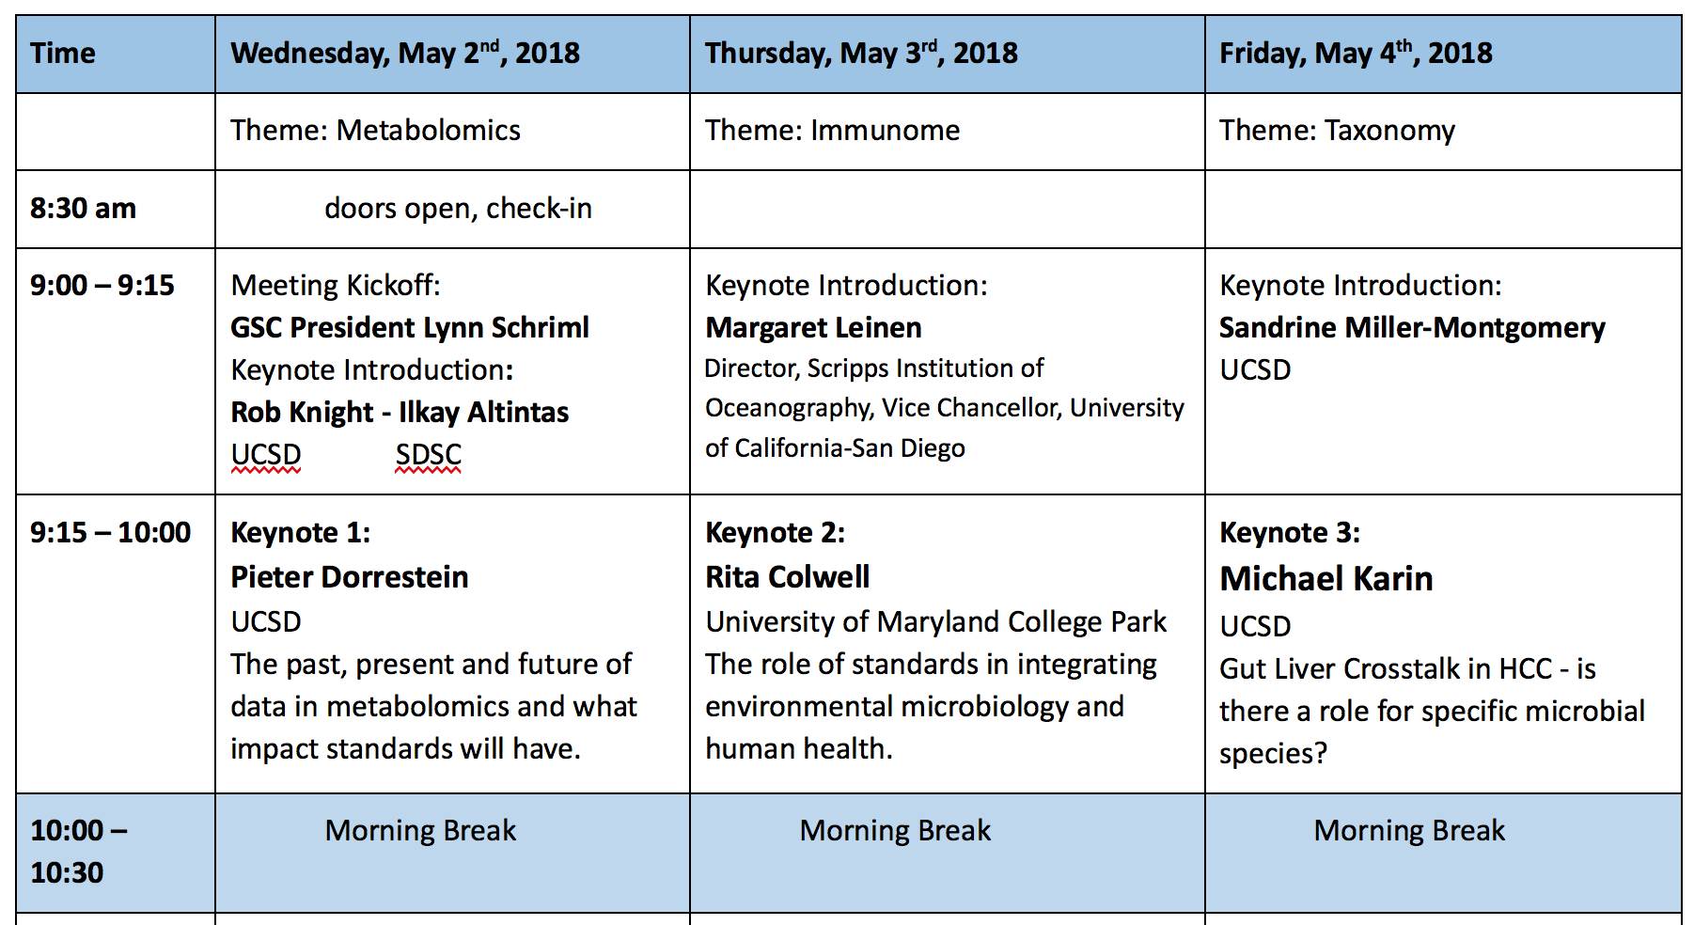

Slide 4
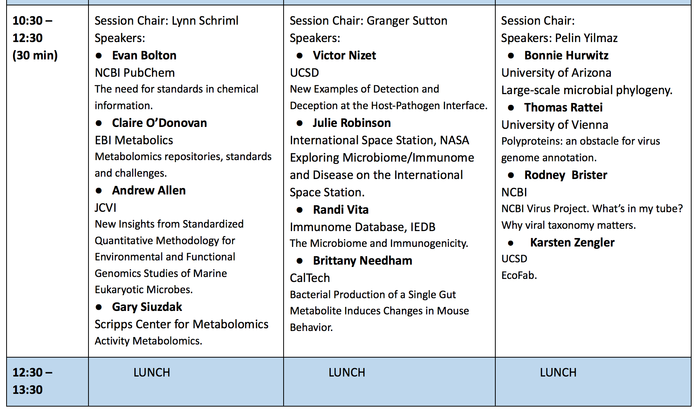

Slide 5
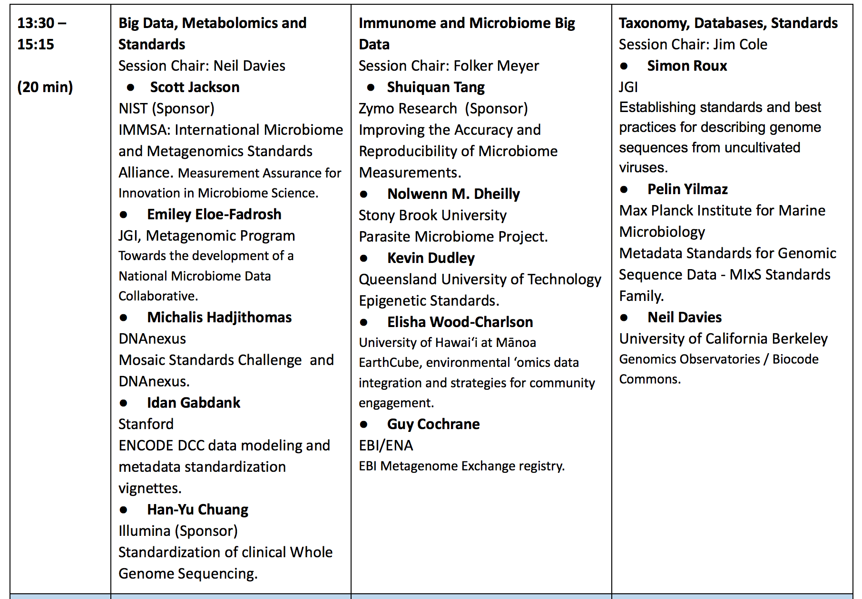

Slide 6
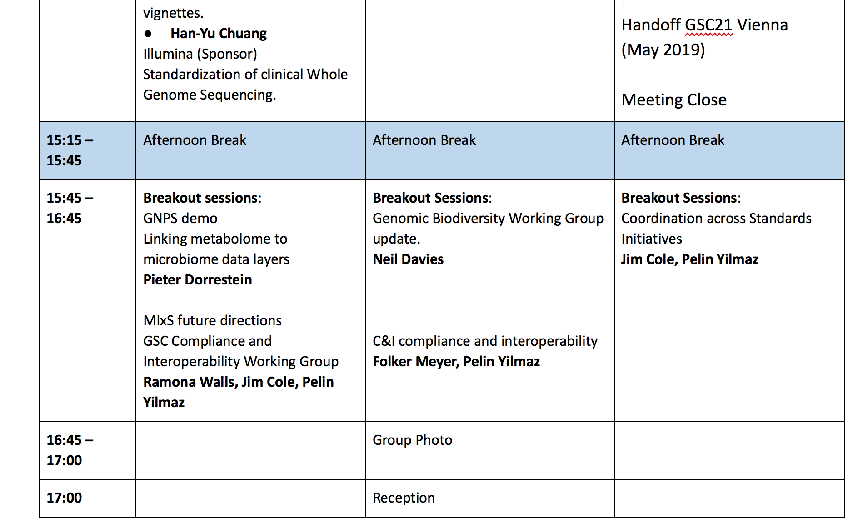

Slide 7
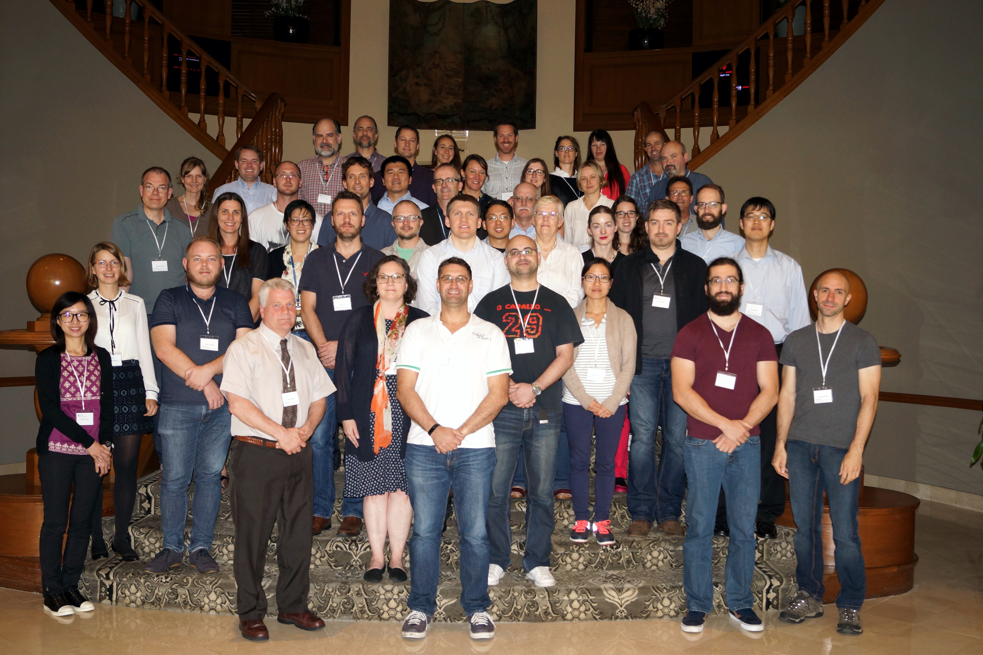
GSC19 – 2017 – Brisbane, Queenslamd, Australia

Slide 8
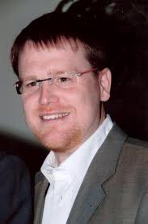
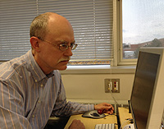

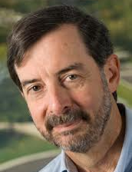

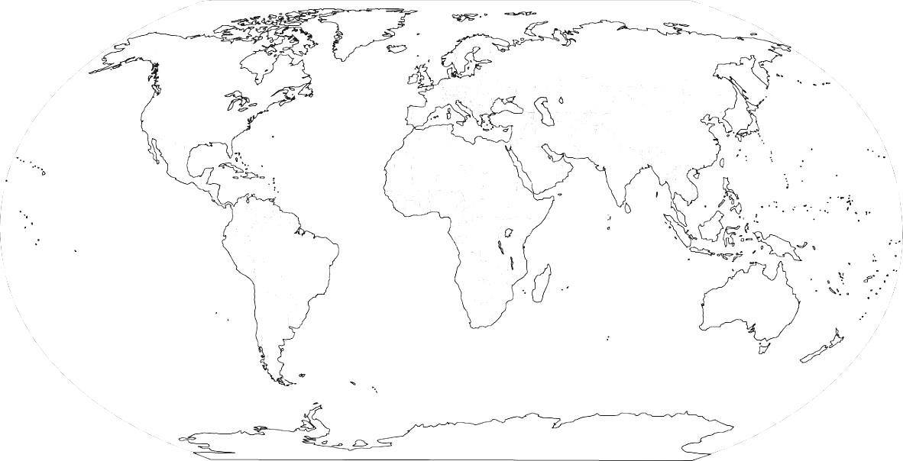
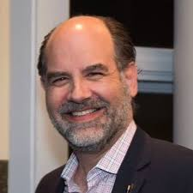
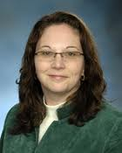


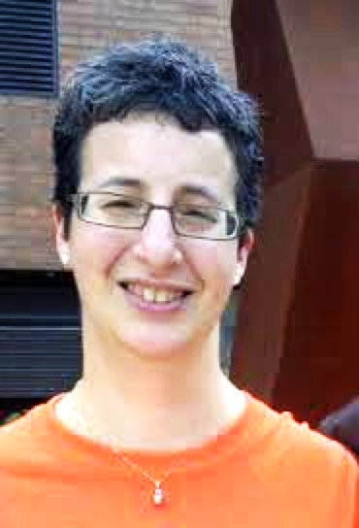


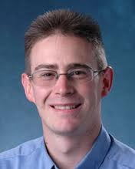
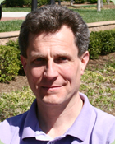



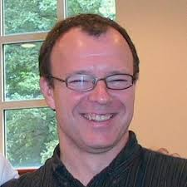
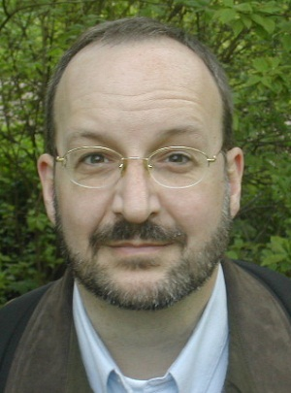
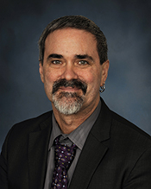

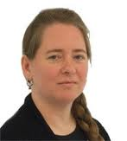
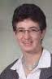


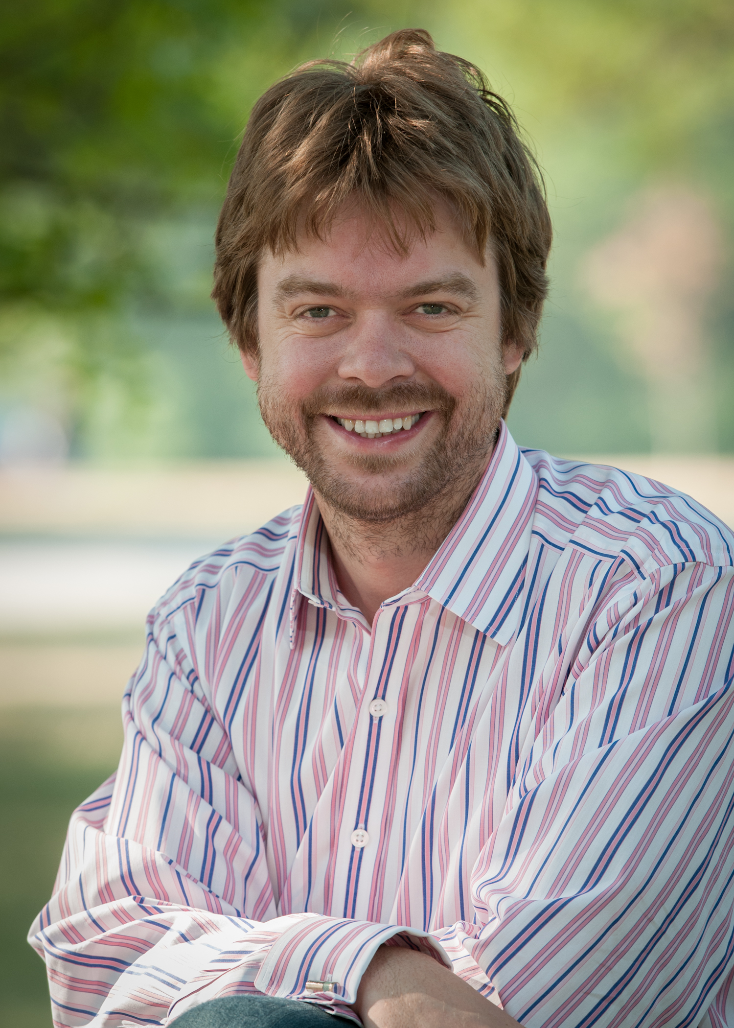
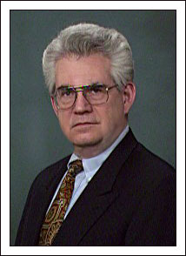
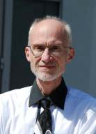
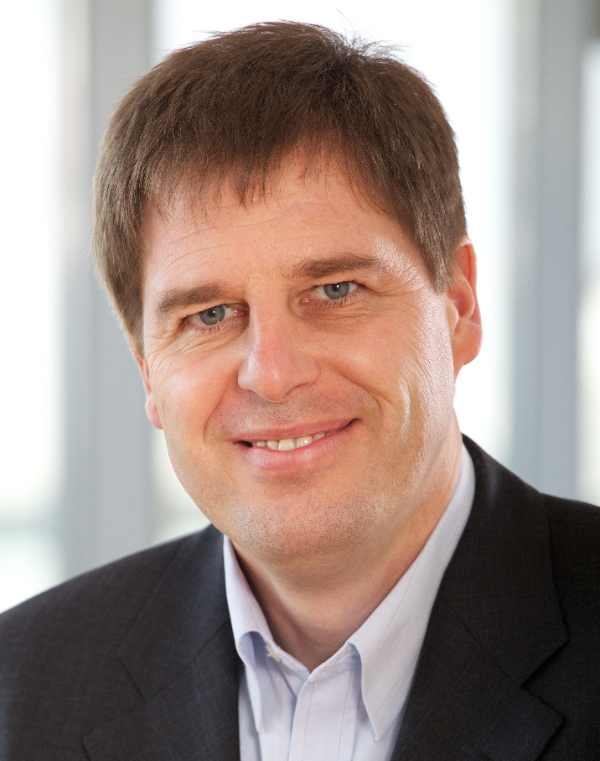

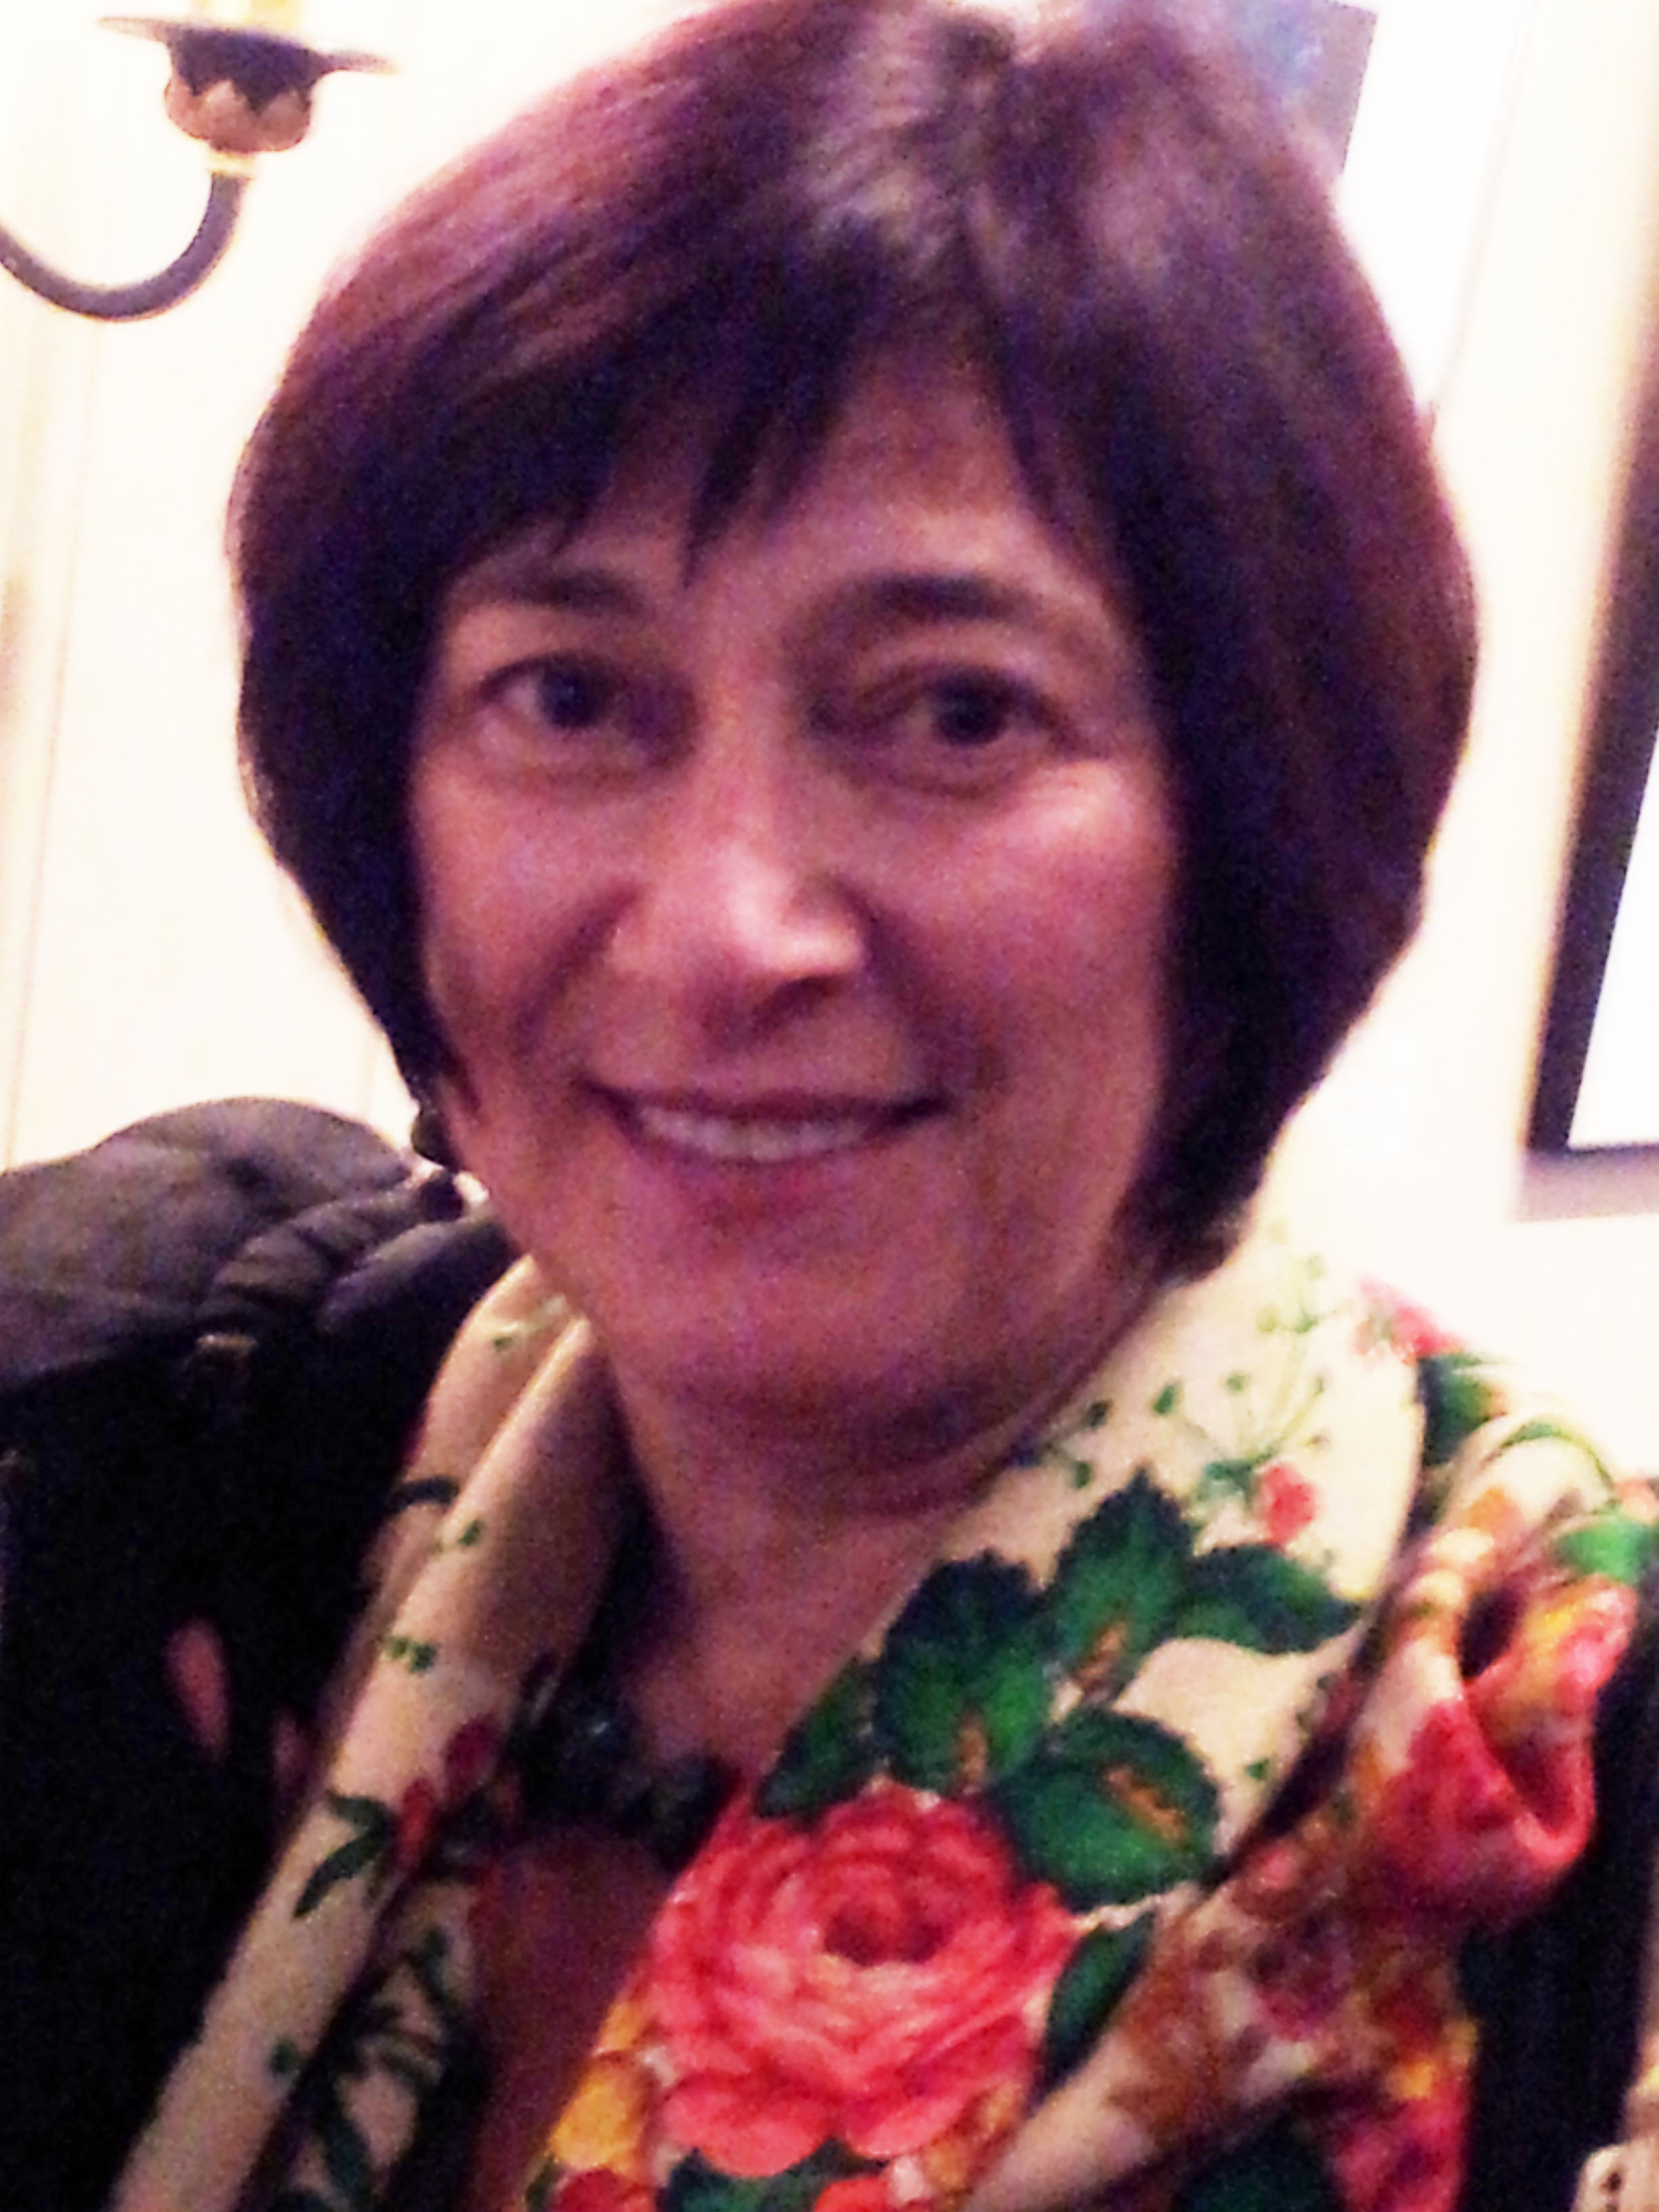
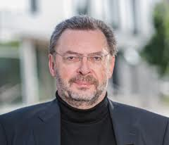
20 GSC meetings (31 total)
UK, Germany,
US, China,
Sweden, Ireland,
Australia, Greece
GSC meetings
GSC members (500 +)
GSC board members
GSC Board Alumnae
Notes:
Fortunate to have highly dedicated board members, -- Driving Force – GSC

Slide 9

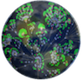













If you build a COMMUNITY,
they will come
BUILD
IMPLEMENT
JOIN US !!!
Notes:
WG’s – please join
We invite you to join us in building community-driven genomic standards

